Slide 1
Landing Page

Slide 2
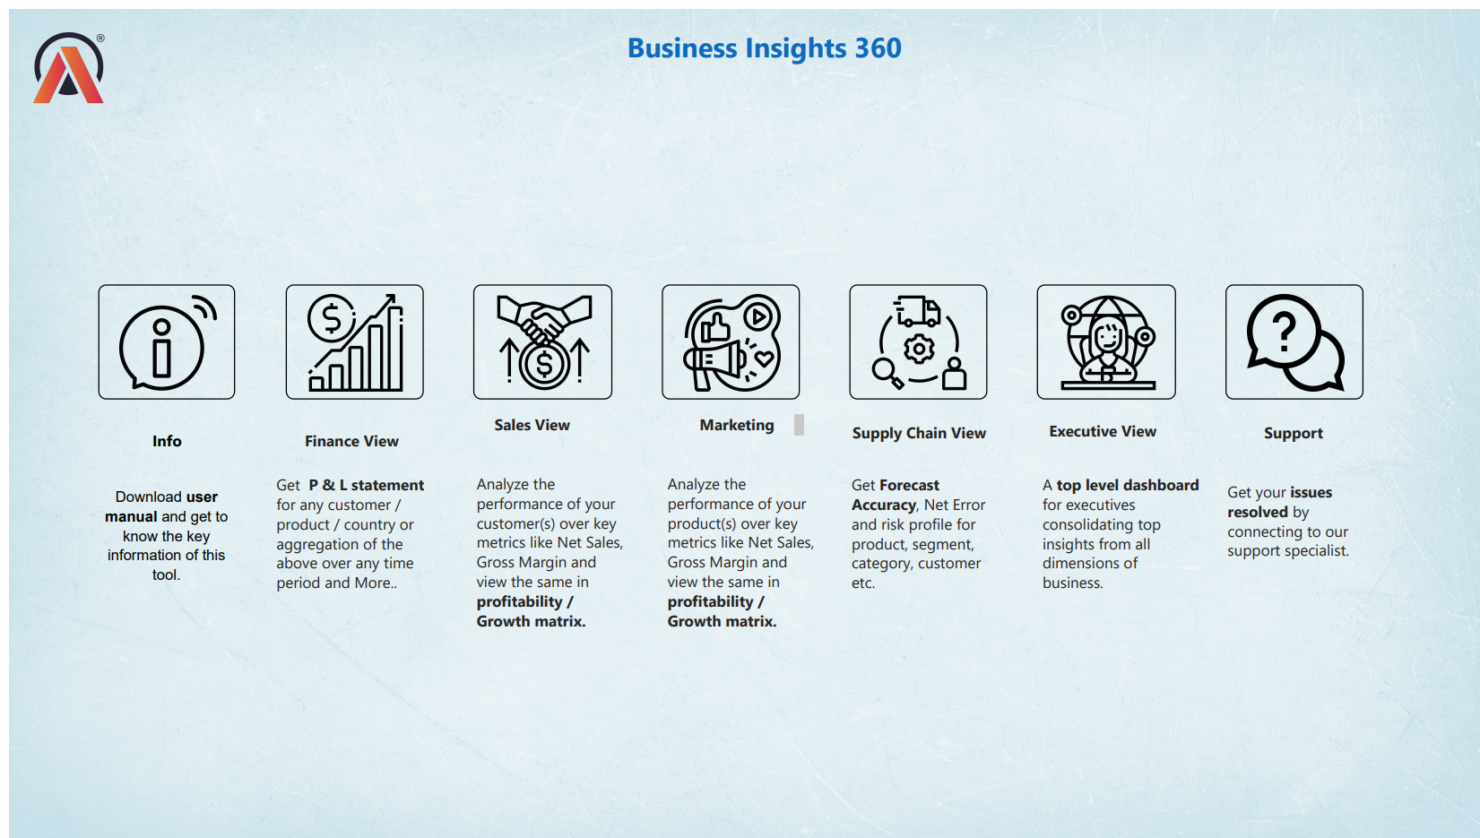

Slide 3
Finance Views

Slide 4
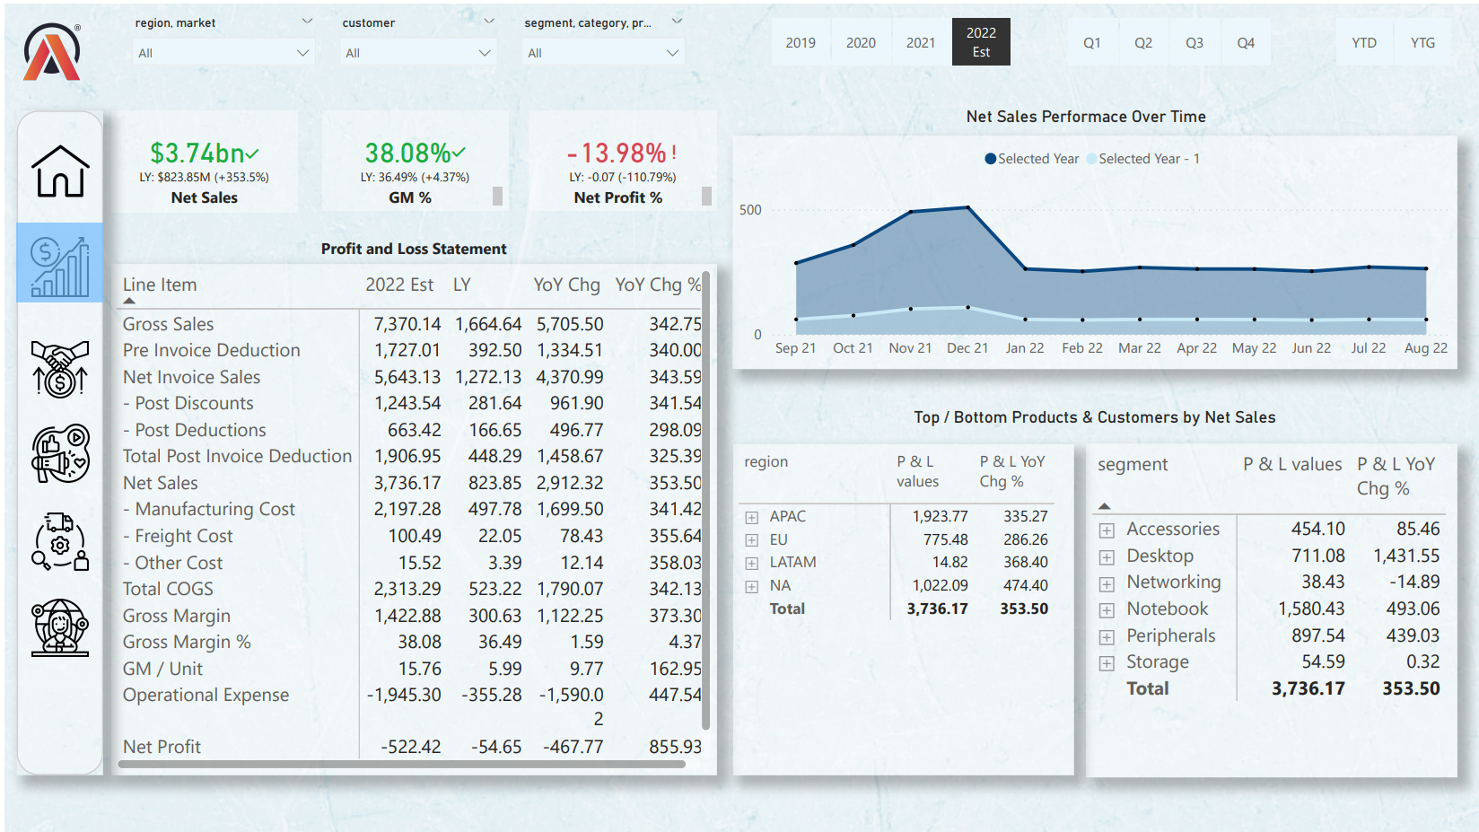

Slide 5
Sales View

Slide 6
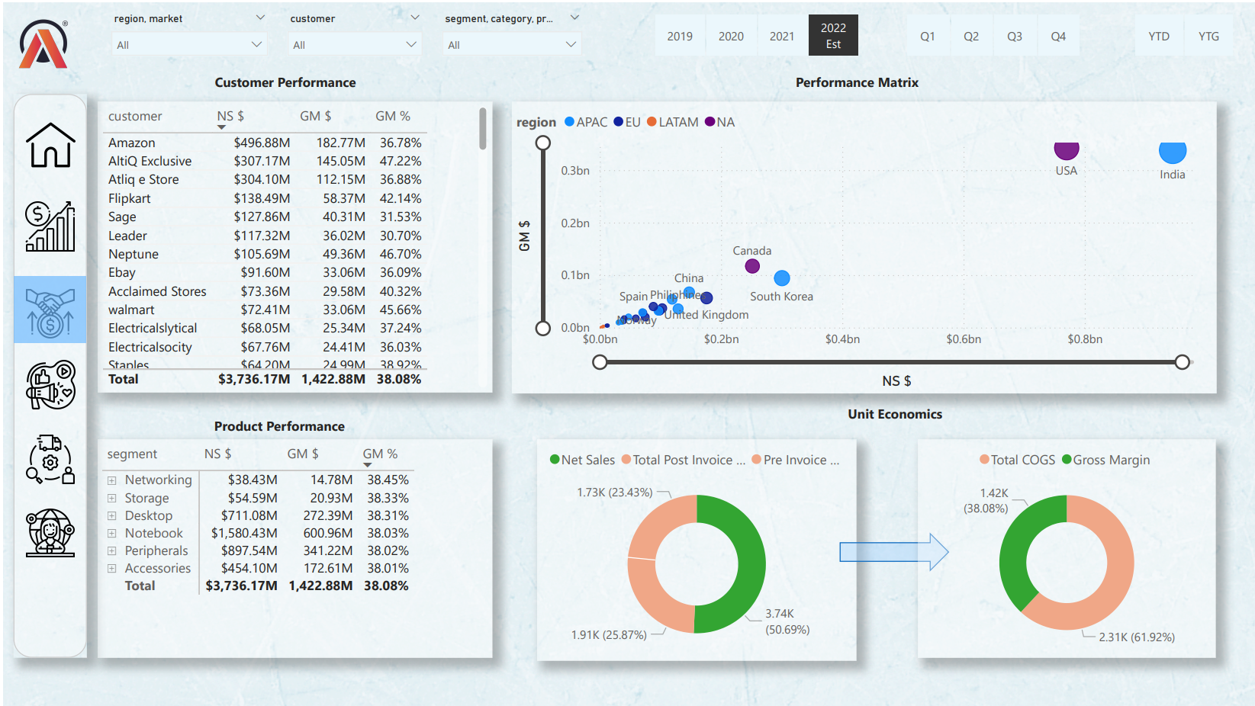

Slide 7
Marketing View

Slide 8
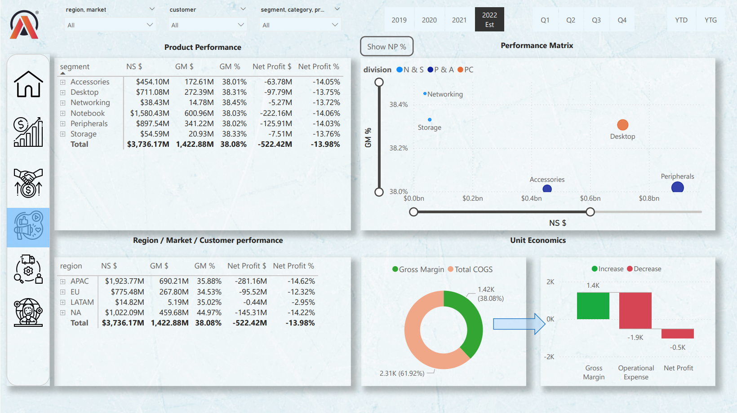

Slide 9
Supply Chain View

Slide 10
